Slide 1
IMAGE SEGMENTATION USING DEEP LEARNING
Under the guidance of : Dr Malay
YOGENDRA SINGH – 18BCS113
KSHITIZ MICHAEL – 18BCS042
LALIT PALARIYA – 18BCS047
VIVEK KUMAR – 18BCS110

Slide 2
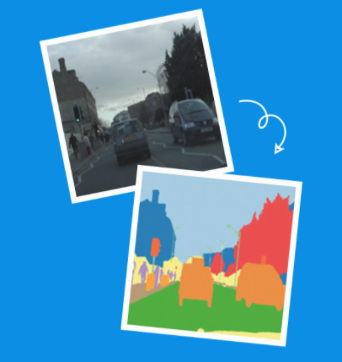
What is Image Segmentation ?
Image segmentation is a critical process in computer vision.
It involves dividing a visual input into segments to simplify image analysis.
Image Segmentation is the process by which a digital image is partitioned into various subgroups (of pixels) called Image Objects, which can reduce the complexity of the image, and thus analyzing the image becomes simpler.

Slide 3
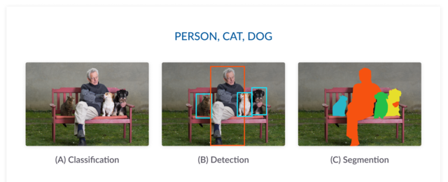
STEPS TO GET SEGMENTED IMAGE

Slide 4
TYPES OF SEGMENTATION
SEMANTIC SEGMENTATION
INSTANCE SEGMENTAION

Slide 5

Terms we will be using:
Convolution
Pooling
Padding
Strides
Un-Pooling (Transverse convolution)

Slide 6

CONVOLUTION

Slide 7


Slide 8
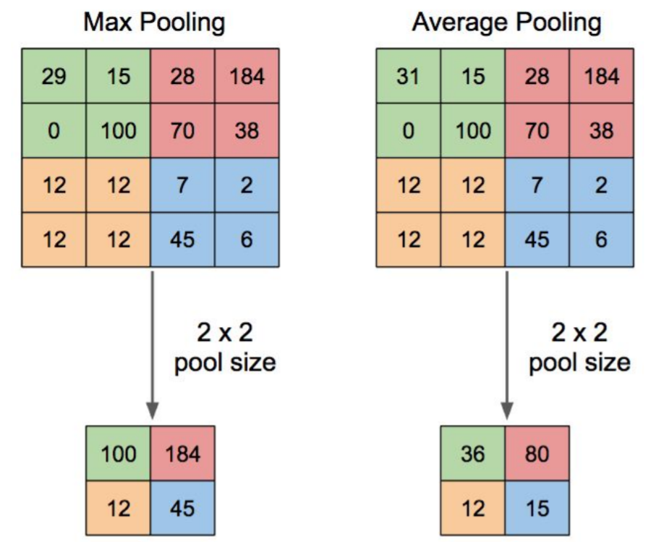
POOLING

Slide 9
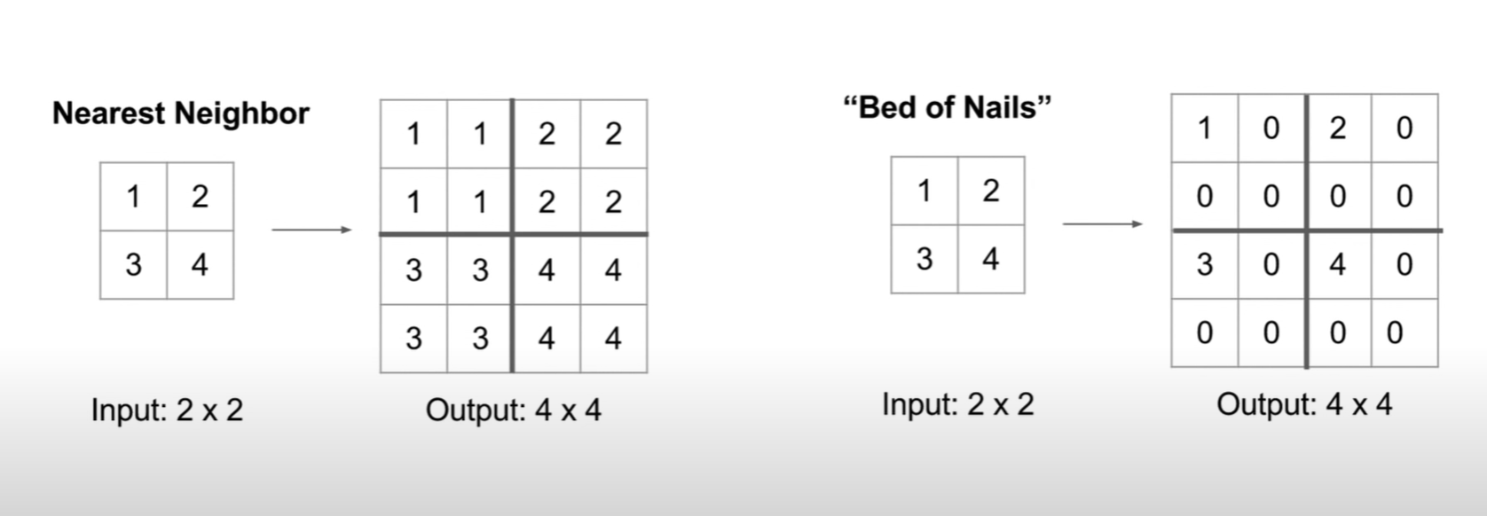
UNPOOLING

Slide 10
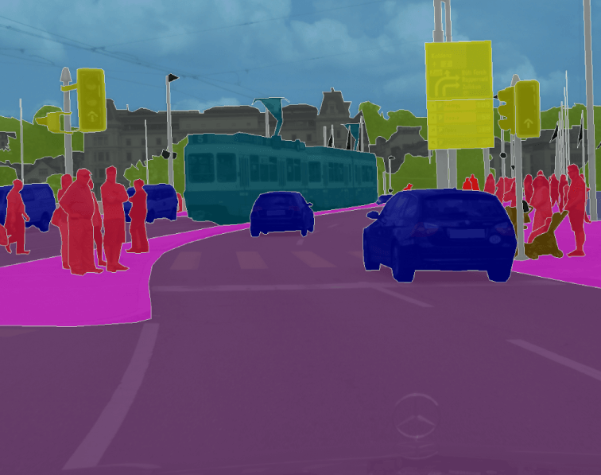
Semantic Segmentation
Label each pixel in the image with a category label.
Don’t differentiate instances, only care about pixels.
Ex: All the cars will have same colour as they belong to same class. similarly all the people will be represented with same colour

Slide 11
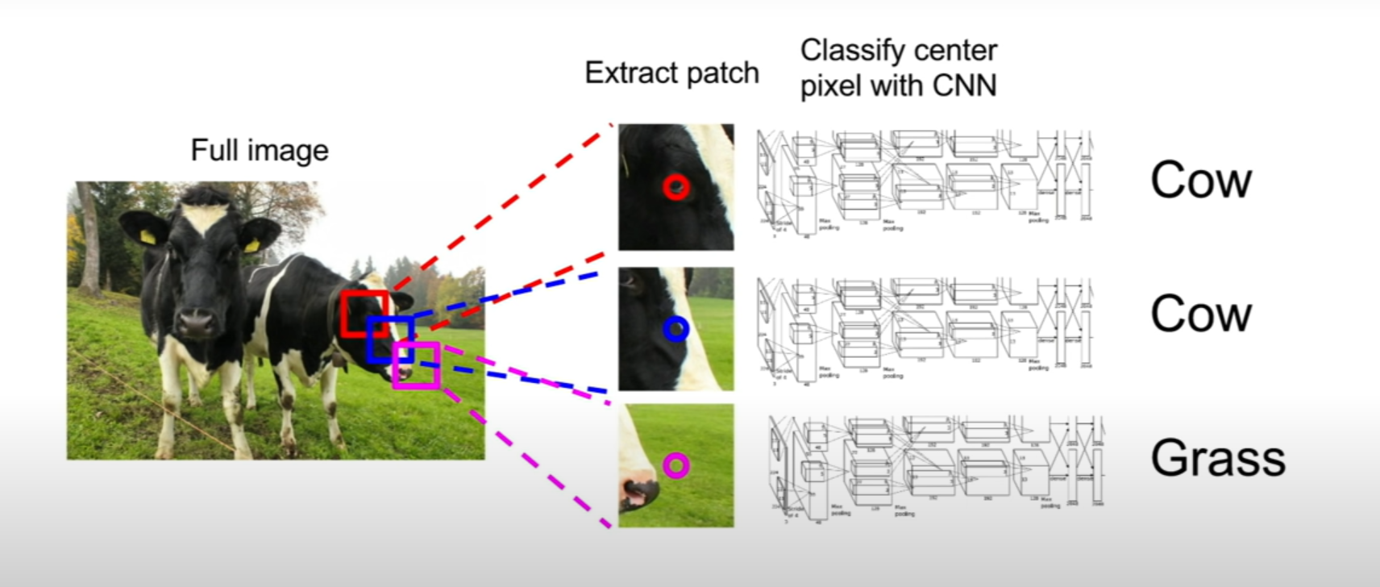
SEMANTIC SEGMANTATION : A SLIDING WINDOW APPROACH
Problem: Very inefficient! Not using shared features between overlapping patches.

Slide 12
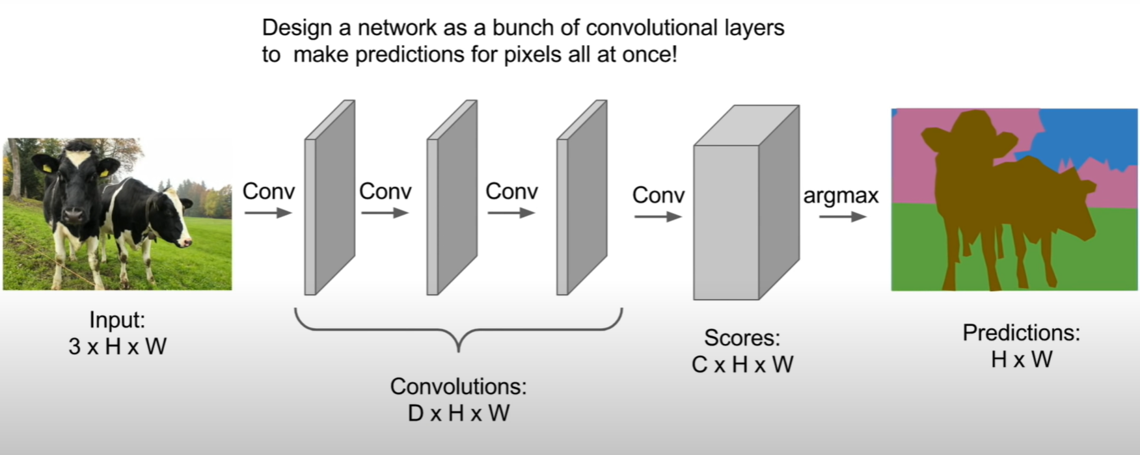
SEMANTIC SEGMANTATION : FULLY CONVOLUTIONAL (I)
Problem: Inefficient! Large computational resources.

Slide 13
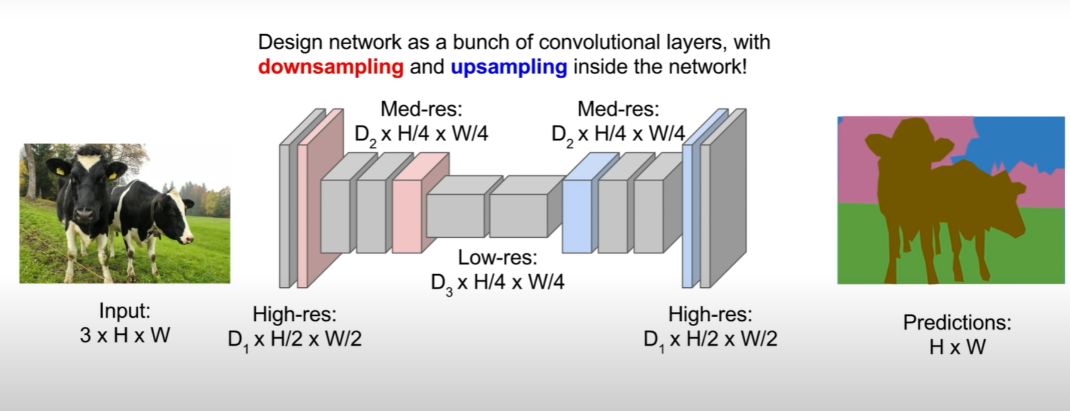
SEMANTIC SEGMANTATION : FULLY CONVOLUTIONAL (II)
Down sampling: Pooling, Strides, convolution
Up sampling: Un pooling, Transverse convolution

Slide 14
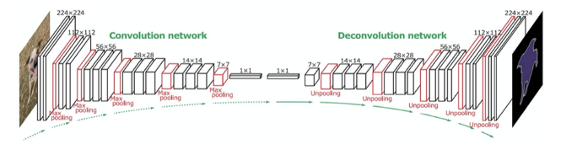
PICTORIAL REPRESENTATION

Slide 15
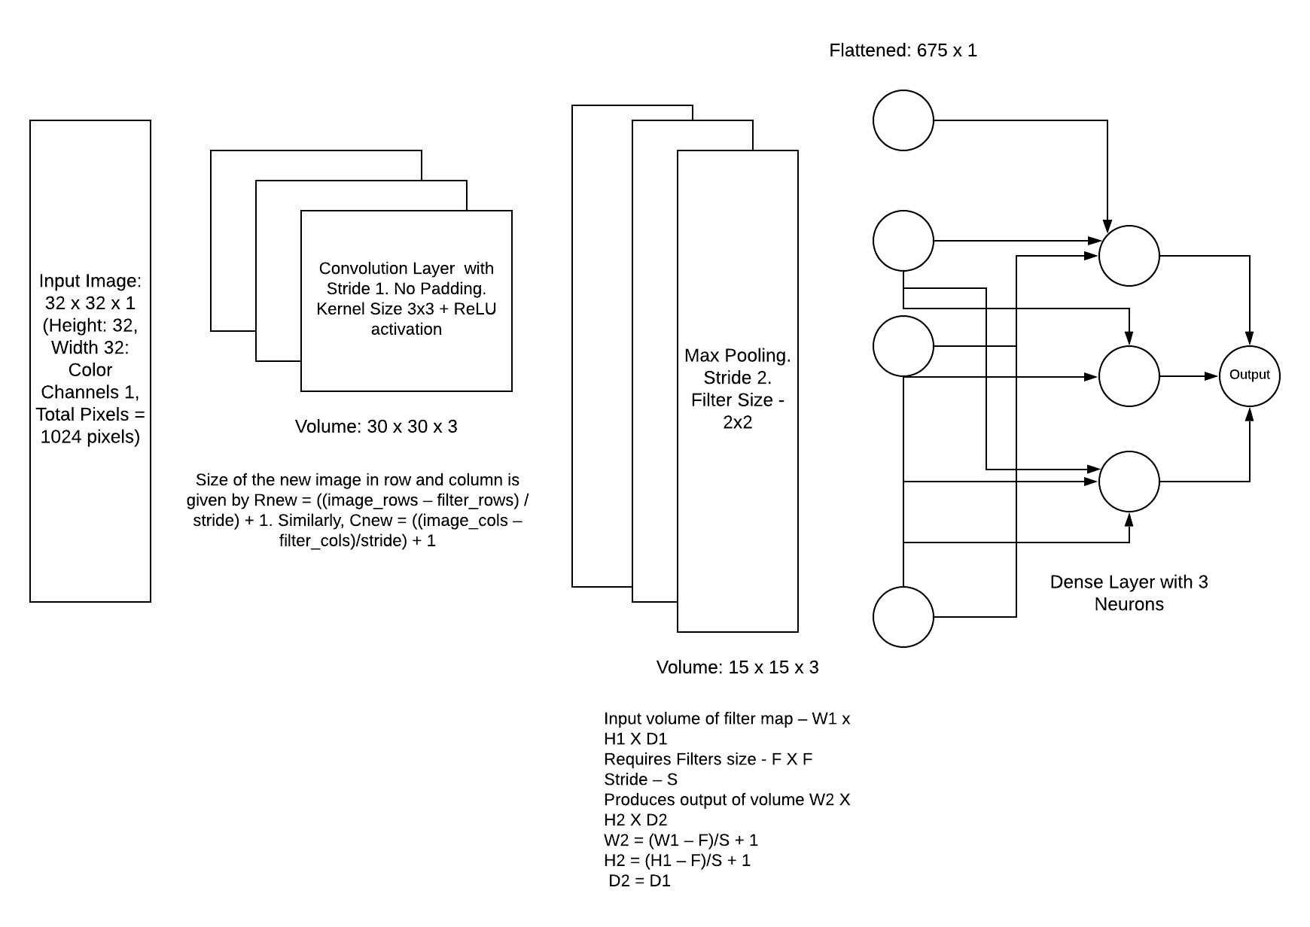

Slide 16
Technologies we will be using:
Tensorflow and Keras
OpenCV
CNN
User Interface to test our model on web/Android app.

Slide 17
U-NET MODEL
U-Net is a fully convolutional network that is used for image segmentation.
Its architecture uses following types of layers:
Conv2D – Simple convolution layers with padding and 3x3 kernel.
MaxPooling2D – simple max pooling, 2x2 kernel.
Cropping2D – layer used to concatenate multiple feature map from different stages of training.
Up-sampling2D – layer that increases size of feature map.
The network is invariant to image size, that means it can accept any size of image
The next slide contain the architecture.

Slide 18
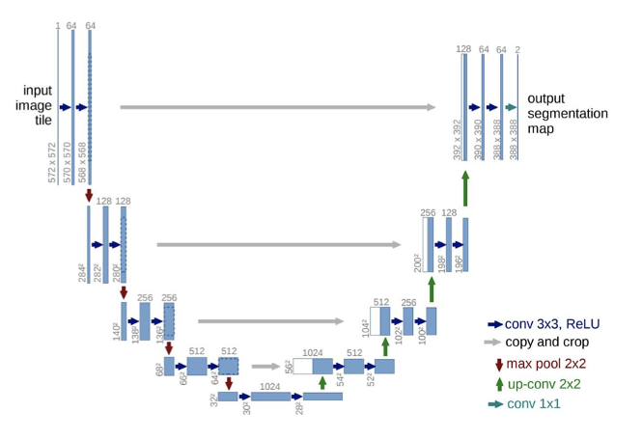
U-NET ARCHITECTURE

Slide 19
Datasets
Oxford Pets Datasets- https://www.robots.ox.ac.uk/~vgg/data/pets/data/images.tar.gz
Carvana Image Masking Challenge- https://www.kaggle.com/c/carvana-image-masking-challenge
PASCAL Image Dataset 2012- https://www.kaggle.com/huanghanchina/pascal-voc-2012

Slide 20
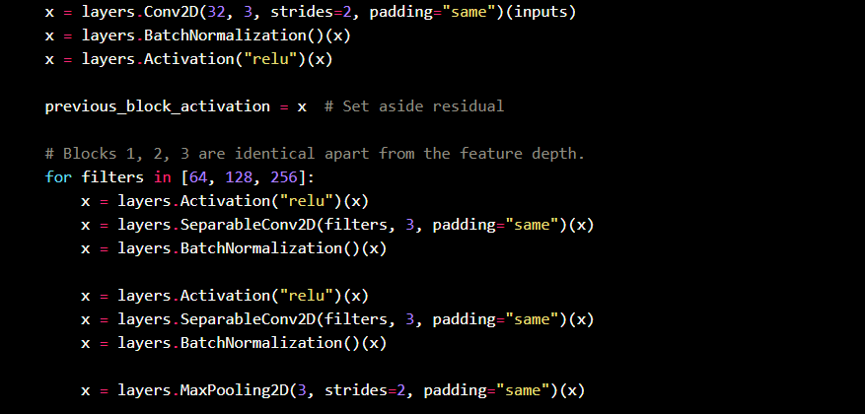
ENCODING U-NET LAYERS

Slide 21
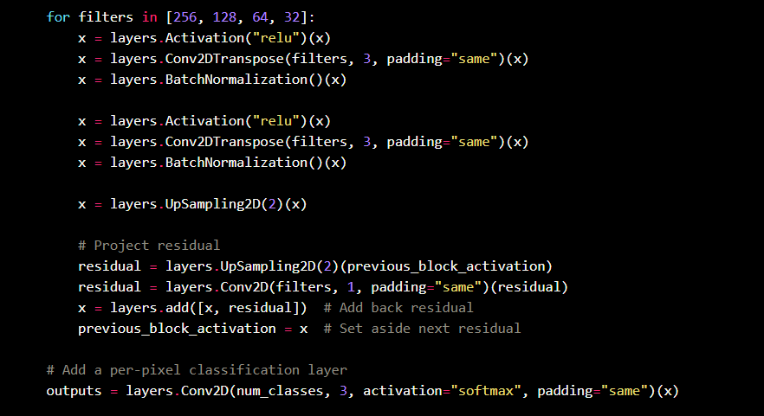
Decoding u-Net LAYERS

Slide 22
EXPERIMENTS
Optimizers:
Adam
RMSProp
Loss Functions
Cross entropy loss
Sparse categorical cross entropy (Not one-hot Encoding)

Slide 23
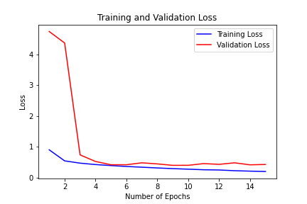
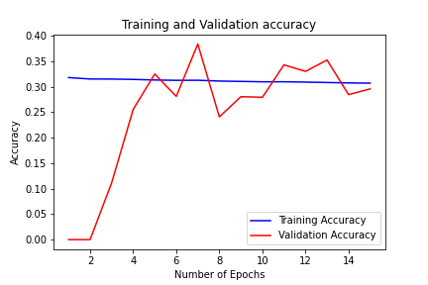
RESULTS
Optimizer: “adam”

Slide 24
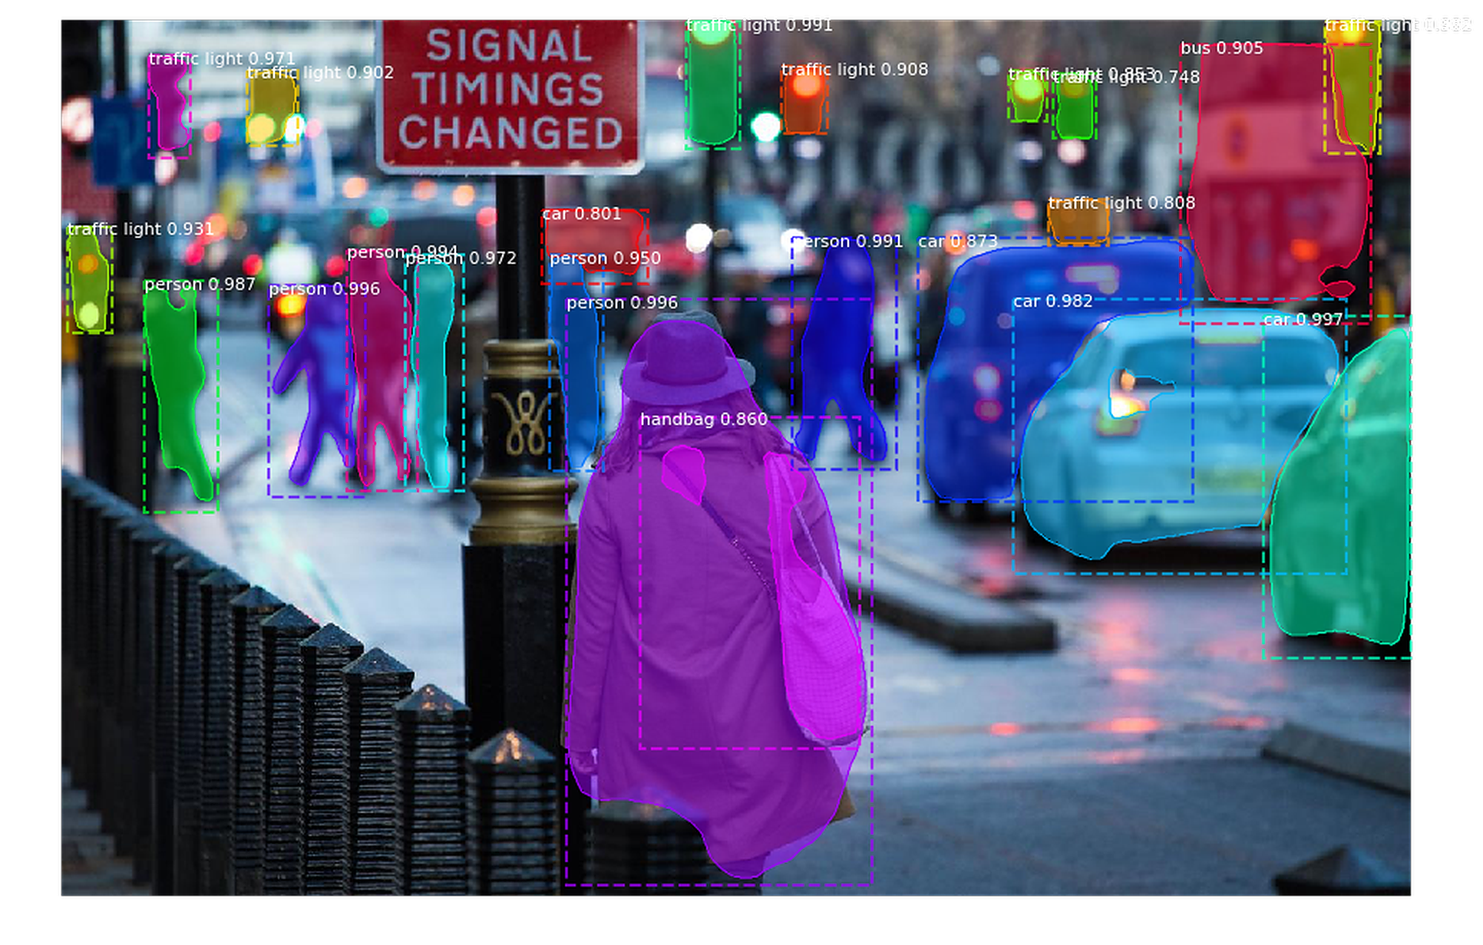
INSTANCE SEGMENTATION
In this segmentation objects are differentiated within a class of objects itself.
That is the cars will have different colour even though they belong to the same class
To get instance segmentation of image we need to localize and detect class of an image.

Slide 25
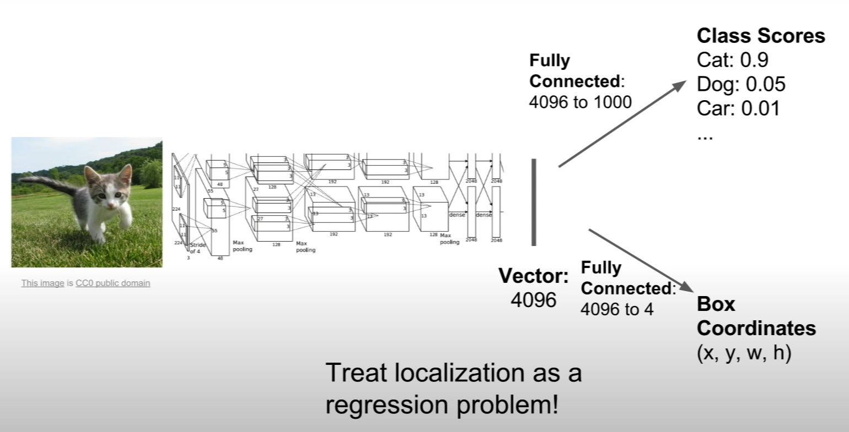
DETECTION + LOCALIZATION
Loss 1: Sigmoid Loss
Loss 2: Region Loss
Attention: we always start with list of categories.

Slide 26
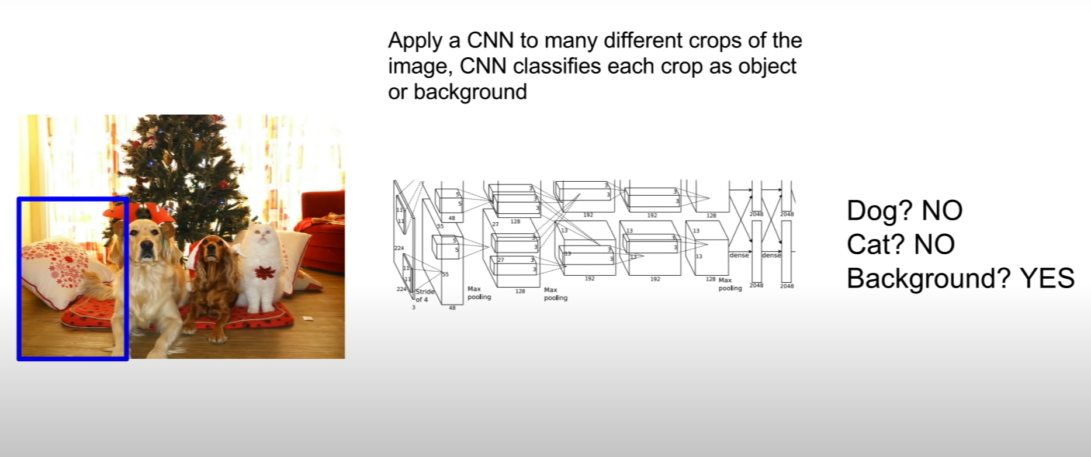
OBJECT DETECTION: A SLIDING WINDOW APPROACH

Slide 27
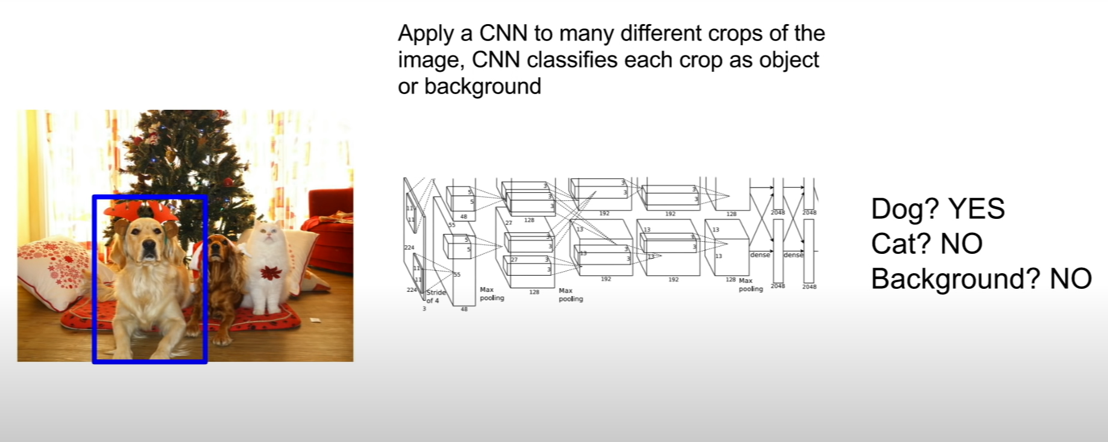
OBJECT DETECTION: A SLIDING WINDOW APPROACH

Slide 28
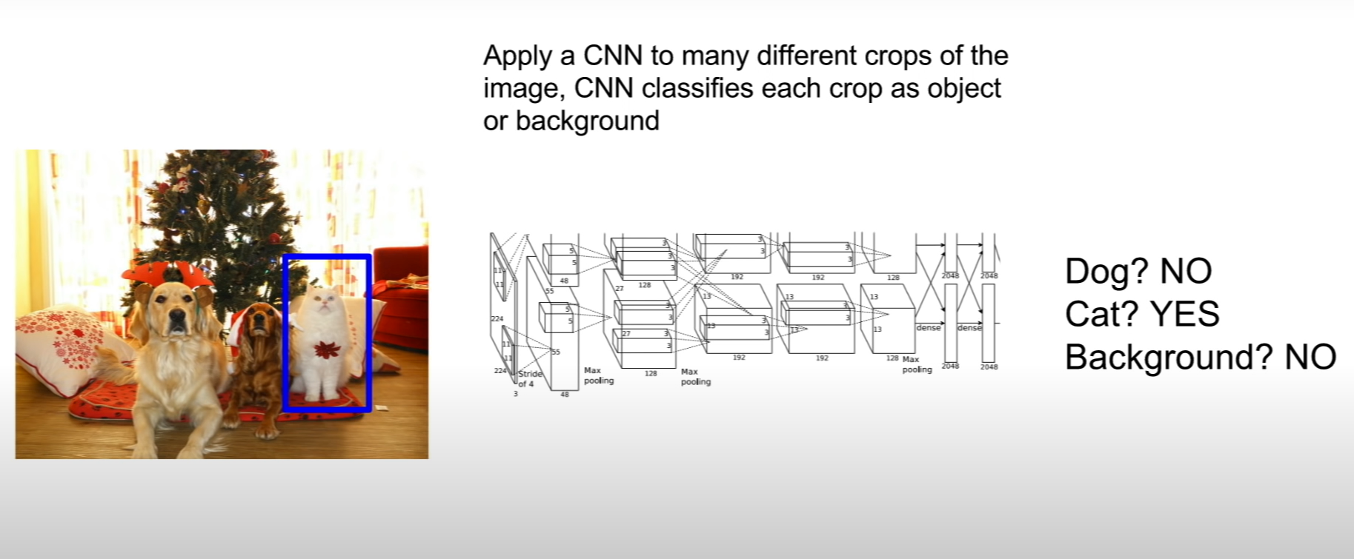
OBJECT DETECTION: A SLIDING WINDOW APPROACH
Problem: We need to apply CNN to huge number of location and scales, Very computationally expensive.

Slide 29
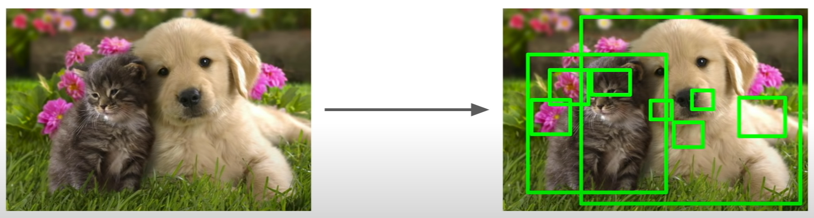
REGION PROPOSALS (R-CNN)
Finds image regions that are likely to contains object.
Relatively fast to run, Selective search Algorithm gives around 1000 region proposals in a few seconds on CPU.

Slide 30
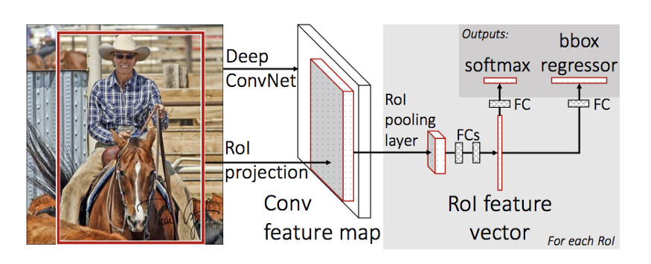
FAST R-CNN

Slide 31
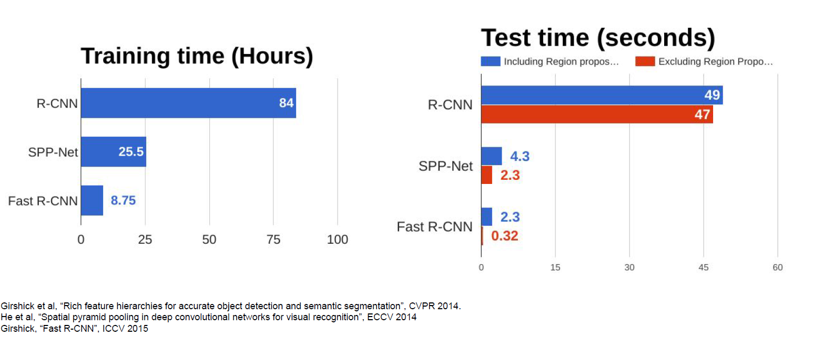
TIME COMPARISON

Slide 32
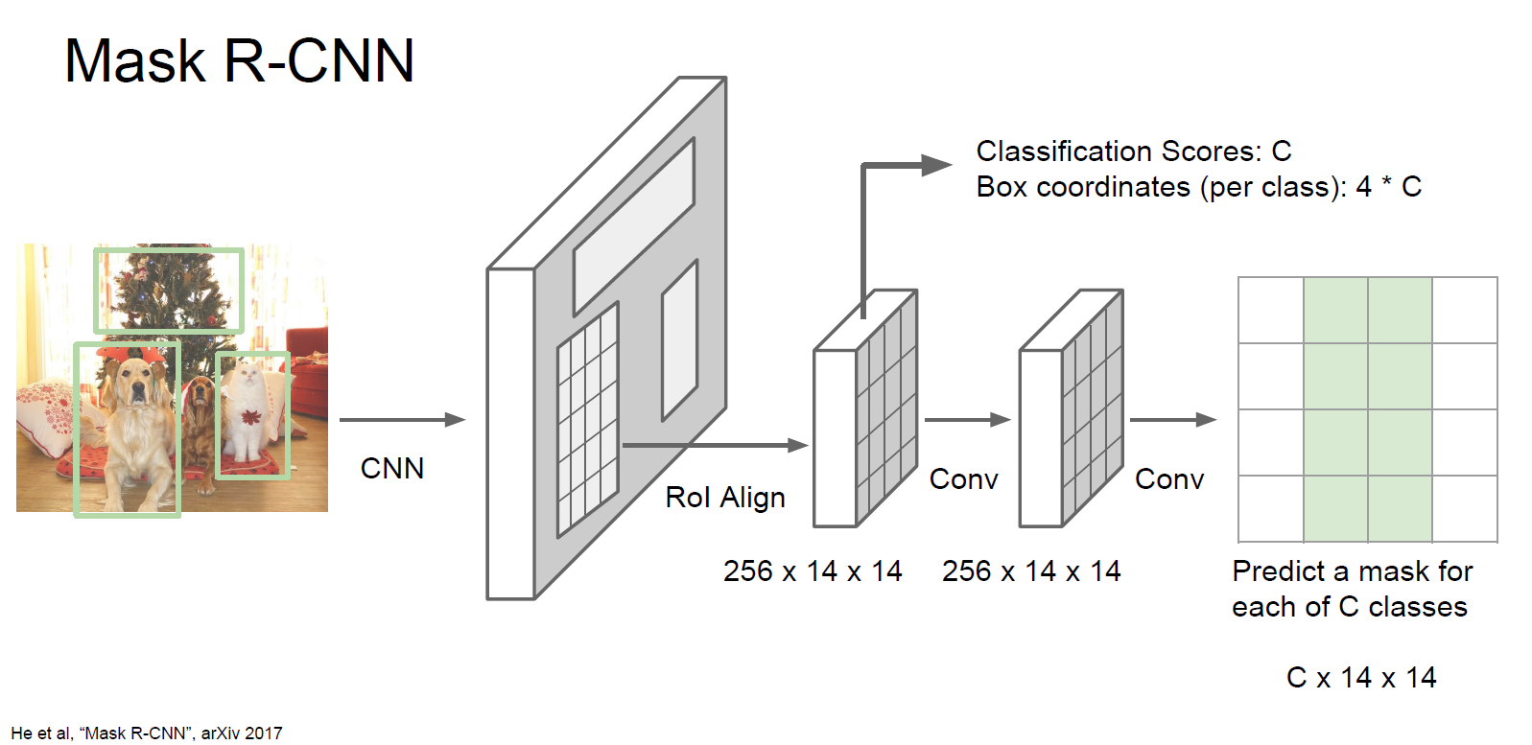
MASK R-CNN
https://github.com/matterport/Mask_RCNN

Slide 33
Future planning:
Face Recognition / Image Classification
Object detection and Removals
Image Identification
Self-Driving Car

Slide 34
References
A Survey on Deep Learning Techniques for Image and Video Semantic Segmentation https://doi.org/doi:10.1016/j.asoc.2018.05.018
Rich feature hierarchies for accurate object detection and semantic segmentation Ross Girshick Jeff Donahue Trevor Darrell Jitendra Malik UC Berkeley. https://arxiv.org/pdf/1311.2524.pdf
Fast R-CNN Ross Girshick (Microsoft Research) https://arxiv.org/pdf/1504.08083.pdf
Stanford University Detection and segmentation (http://cs231n.stanford.edu/slides/2017/cs231n_2017_lecture11.pdf )
https://keras.io/examples/vision/oxford_pets_image_segmentation/
https://github.com/matterport/Mask_RCNN

